Slide 1

Ecuador Retail Sales Analysis
Group 3 - Elmeri Jokinen, Fuzel Shaik, Anssi Savallampi, Juho Syrjä, Lauri Uuniemi

Slide 2

The Assignment
Gain insight into the regional, categorical and seasonal changes in demand
Find out top sellers and top product categories and their progression of sales throughout the period.
Analyze the efficiency of product promotions across the retail chain
Analyze the potential impact of oil prices and holidays on sales.
CRISP-DM framework

Slide 3

The Business
Operational efficiency crucial to stay competitive
Optimizing supply to meet demand is one key area of this efficiency, especially with perishable goods

Slide 4
The Data & Preparation
Contains sales table, stores table, transaction table, and holiday tables.
Information of number of sales, products, date, promotional information, store location…
Data was found to be quite clean, so preparation didn’t take too much time
Imported CSV files to Tableau and check for missing or duplicate values.
Exploratory Data Analysis through charts and graphs (Detect patterns)
Basic statistical analyses (mean, median etc.)

Slide 5
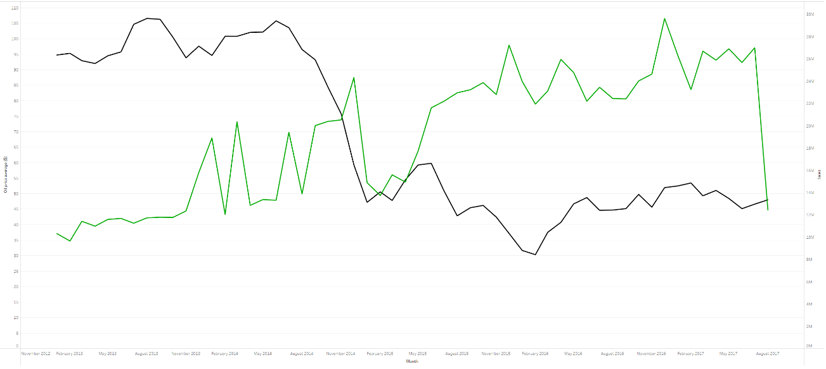
Modeling & Deployment
Sales demand - Time series forecasting (Exponential Smoothing) → Linechart
Promotional Efficiency – Linear regression & Pearson correlation → Scatterplot & heatmaps (treemap with color)
Holidays & oil – Basic Chart analysis

Slide 6
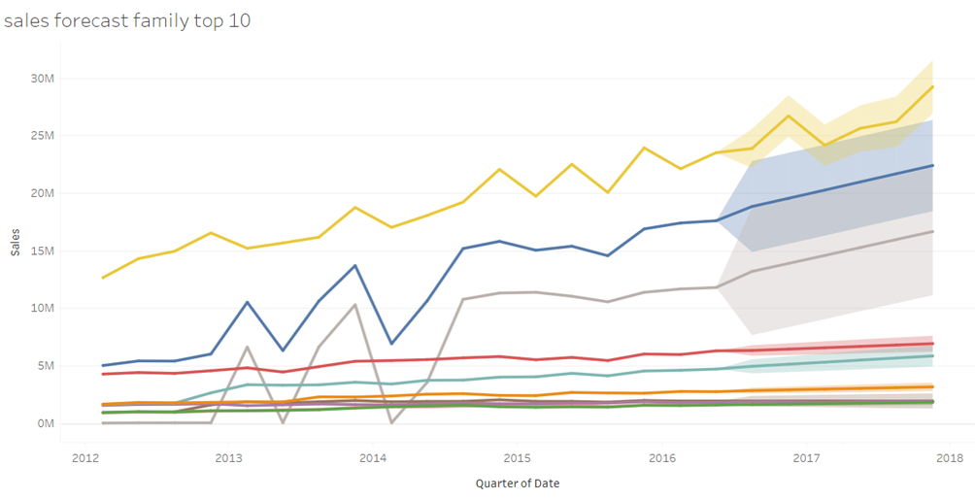
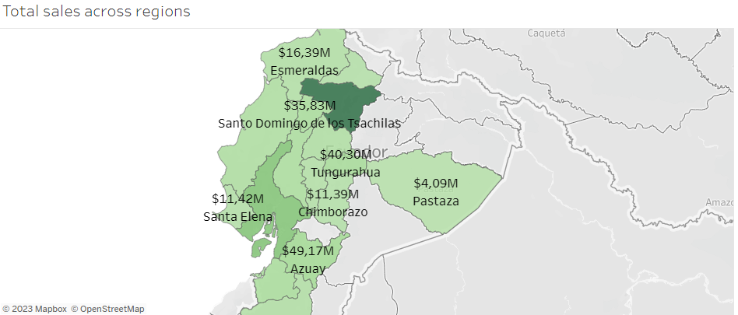
Analysis of sales & forecast
Overall view of sales volume regionally
Forecast particularly useful for the most sold product families (Grocery, Beverage, Produce)
Quarterly forecasts were used in the dashboard, shorter forecasts were too inaccurate
Other product families’ sales were consistent over time.

Slide 7
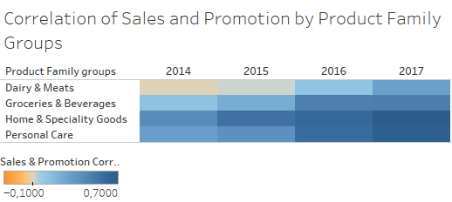
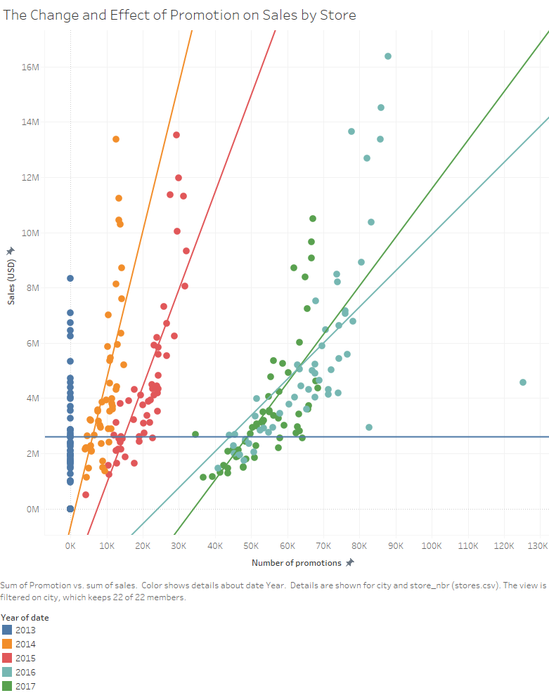
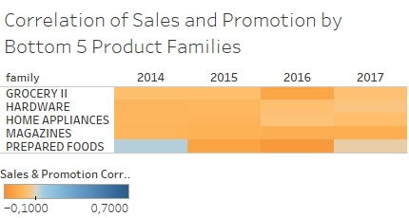
Analysis of Promotions
Large stores (by sales) seem to derive the most benefit from promotions
Promotion and sales correlation progressing over time (weak correlation → strong correlation)
Certain weak promotional product groups were identified

Slide 8
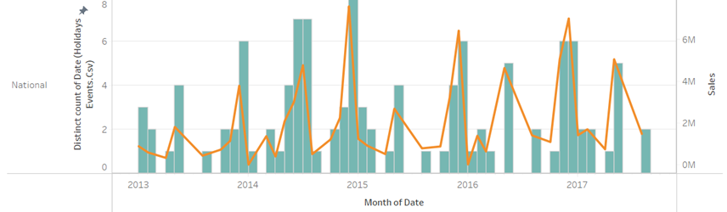
Analysis of holidays
Main holidays are Christmas and the Carnival (spring-time)
Sales growth around the holidays consistent with the overall growth rate of the company

Slide 9
Analysis of Oil prices
There seems to be a negative correlation between sales and crude oil prices
The drop of oil price could be both a drop in operational business costs all over the country, leading to people having more disposable income to spend

Slide 10

Thank You!
Up next: Dashboard demonstration

